Slide 1
Descriptive, Inferential and Regression Analysis
Notes:
1
SBS Advisory Board - 10th July 2013

Slide 2
Statement of Hypotheses
Research Question 1: Education level doesn't effect the wages of the people, or wages are not higher for people with more education.
Null Hypothesis 1: Ho = B1=B2=B3=Bn= 0
Alternative Hypothesis 1: H1 = one of the Beta(coefficient) is not equal to zero
Research Question 2: Are the wages for the males are higher than the female.
Null Hypothesis 2: “wages are less or equal for the female"
Alternative Hypothesis 2: “wages are high for the female"
Significance level:
The Significance level is 0.05, for all these assumptions:
i.e., α = 0.05

Slide 3
Description of the data and Descriptive Analysis
This data contains the wages of the 518 people and their some personal information to assume that may affect their wages.
The data is cross-sectional having one continuous variable(wage) and 8 categorical variables like education, experience, age, gender etc.
There is one big outliner which is affecting the over all data, so I spotted and remove it from the data. We can see the difference in the plot of with and without outlier.
The following charts/plots and table represents the descriptive Analysis of data:
Notes:
Cross sectional is a data which is collected from all the participants at the same time. Time is not considered as a study variable during cross sectional research.

Slide 4
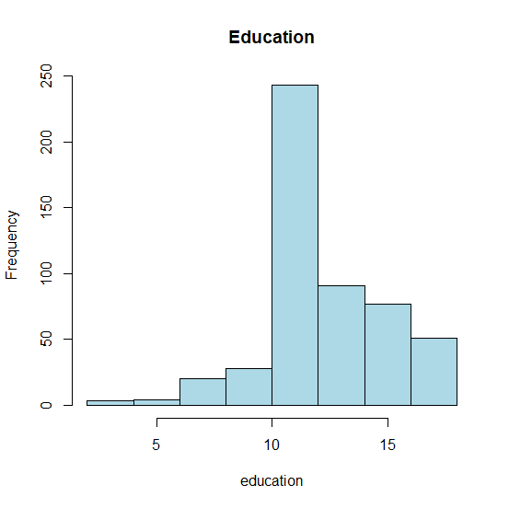
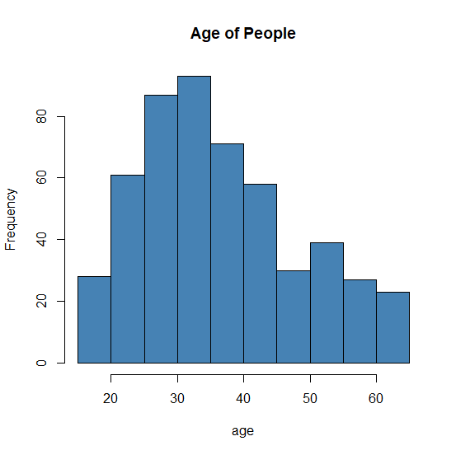
Histograms for Education and Age of people

Slide 5
WITH OUTLIER

Slide 6
WITH-OUT OUTLIER
Notes:
The central line of the boxplot reprsents their means and the upper line represents their variance.

Slide 7
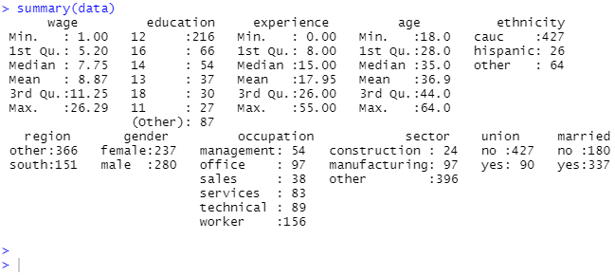
Description of the data and Descriptive Analysis
Notes:
There is descriptive statistics of all the variables. Mean, median, max min of wages data and as the other variables are not continues and categorical/factor so the count of all the categories are given.

Slide 8
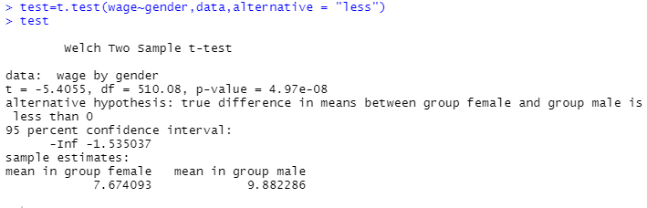
Inferential Analysis
T-test:
Here we apply t-test to see is the wages of male are equal or we can se that the difference of wages of female and male is zero.

Slide 9
Results and Conclusion
Results: In the last slide the T-test is applied to test the differences between the means of to category.
From the result we get
The t-value= -5.4055 with degree freedom = 510, to compare it with the table value. But we are also given a p-value = 4.97e-08, to directly compare it with the Alpha value α = 0.05.
And in the last we have the means of the male and female.
Conclusion:
As we can see the p-value is way small than the α = 0.05, so we reject the null hypothesis that the means of male and female wages are equal.
And from the means we can say that the wages of the male is more than the female.

Slide 10
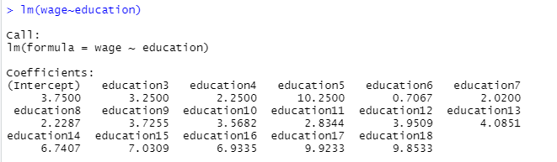

Regression Model
Simple linear regression is applied to see if wages estimated to be higher where an individual has higher levels of experience.
is wages higher for people with more education or not.
By linear model we get all the coefficient of the education level with the Multiple
R-square, Adjusted R-square and p-value to test the hypothesis.

Slide 11
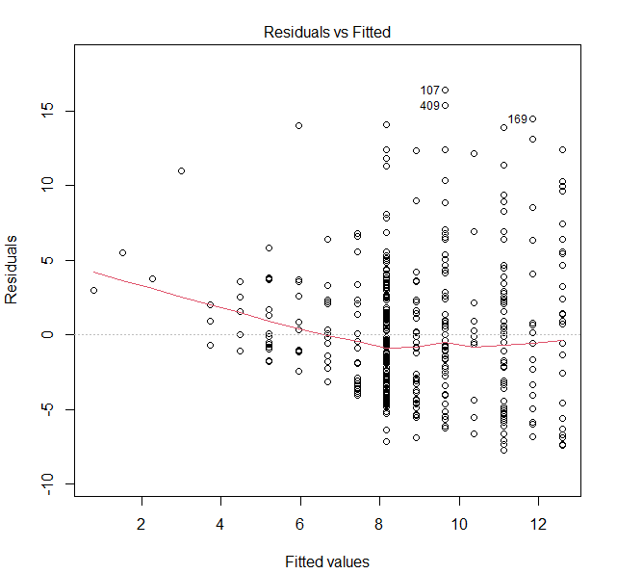
Plot On Residual An Fitted Values

Slide 12
Results and Implications
Results: From the following output of R, have all the coefficients of the levels of Education. And from the summary of Regression line we have the R-square= 0.1968 and p-value = 2.823e-16.
Conclusion:
From the result we clearly see that the coefficient of higher education level are bigger than the lower education, So we can say that the wage are statistically higher for the higher level of education.
But also for Education at level 5 the coefficient is highest but if we see the whole linear model the coefficients are greater for increasing order of education level.
R-Square tell us how much the Education variable explains/contribute in the wages.
And as we can see the P-value is very small so we can reject the Null hypothesis, and accept the Alternate Hypothesis.

